Slide 1
Intercultural Activity Design
Caropat, 2007
Sarah Wroblewski
FLT 815- Dr. Lanier
Spring 2018

Slide 2
“Interact” Activity Summary: Bullfighting debate
Based on Corbett, 2010, p. 193: 10.6 Debate on blood sports
Communicative modes: interpersonal speaking, although contains all modes (presentational speaking, listening, writing, reading)
Description: Students will research and debate the issue of whether Spanish-speaking countries such as Spain and Mexico should or should not allow bullfighting (i.e. whether it is a violation of civil liberties or not). Students may have their own viewpoints but will improve persuasive skills by researching and understanding values of those who disagree. (Corbett, 2010, p. 193)

Slide 3
Context
Diploma Program (DP) Spanish
Part of the International Baccalaureate program
Intermediate mid to advanced low proficiency on ACTFL scale
U.S. high school students, juniors and seniors
Diverse group, few to no native or heritage speakers of Spanish
Lesson would take about 3-4 class periods (50 min each)
Hatyza, 2015

Slide 4
Objectives
Students will be able to:
Exchange information in a debate on bullfighting using researched topics, using complete sentences and asking/answering a variety of questions (NCSSFL-ACTFL, 2017)
Explain, present, and evaluate preferences, arguments, and opinions on the topic of bullfighting, and provide evidence to support or refute these statements (NCSSFL-ACTFL, 2017)

Slide 5
Objectives
Students will be able to:
Recognize that significant differences in opinion and behavior exist within Spanish-speaking culture on the topic of bullfighting (NCSSFL-ACTFL, 2017)
Follow the main message to interpret straightforward, sometimes descriptive informational texts (NCSSFL-ACTFL, 2017)

Slide 6
Materials
1 device per student with Internet access
1 copy per student of the tauromaquía worksheet
1 whiteboard (for the teacher)
Smartphone hand screen (2017)

Slide 7
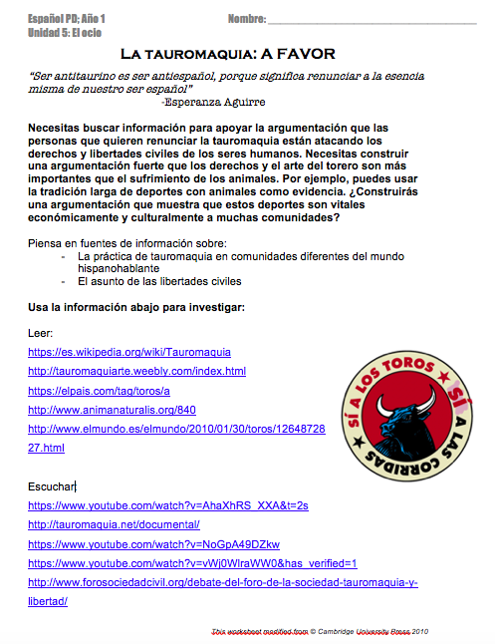
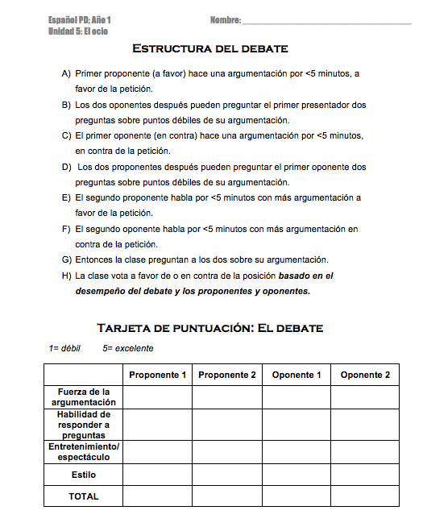
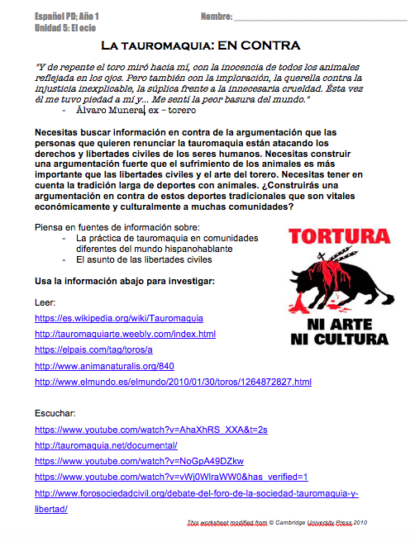
Preparation & Materials
Materials:
1 device per student with Internet access
1 copy per student of the tauromaquía worksheet

Slide 8
Preparation
Prior to this lesson, students need to be familiar with:
How to research on the Internet and determine validity, reliability, and utility of sources; how to cite sources properly
Debate phrases such as I agree or On the other hand, etc. (more about this later)
Basic vocabulary related to bullfighting (bull, stadium, bullfighter, etc.)

Slide 9
Lesson presentation
Hello! How are you?
Snap Inc. (2018)

Slide 10
DÍA 1: Day 1
AGENDA
Calentamiento
Discusión y formulación de ideas
Instrucciones para un debate
We are going to start with a warm-up. What do you already know about bullfighting? Think for a moment… Now, talk with a partner about what you know and what we’ve learned so far.
Hello students! Today we are going to discuss bullfighting. We’ve already talked about the activity and we know the vocab, but we haven’t gone into the specifics of the sport.

Slide 11
5 minutos
Palomaironique (2012)

Slide 12
Thank you! I heard many great ideas and information. We are going to consider a question: do you think bullfighting should continue? For example, some people say it is art. Others say it is torture. What do you think?
Please work with your group of 4 to formulate arguments BOTH for and against the abolition of bullfighting. I recommend picking one student as a scribe to write your ideas. Afterwards, be ready to share out with the whole group.

Slide 13
A favor En contra
Es tortura Es arte
Here is an example of the chart you could make. You have 7 minutes. Let’s go!

Slide 14
7-10 minutos
Palomaironique (2012)

Slide 15
Okay. Now let’s have each group share out and I will record on the board. Don’t say any ideas that another group has already said, so listen to your peers! Let’s start with group 1…

Slide 16
A favor En contra
Crueldad Tradición
a animales Libertad Mucha civil
violencia Economía

Slide 17
You had some great ideas. Now we are going find out more. You are going to research bullfighting to find out more for a class debate on _____day. Everyone will be assigned a position.
Very good! Now let’s talk about what we’re going to do for the rest of today and tomorrow.

Slide 18
La abolición de la tauromaquía es una negación de los derechos y libertades civiles (The abolition of bullfighting is a denial of civil rights/liberties)
This the is statement you will be debating. In favor: Bullfighting needs to be abolished as it is cruelty to animals. Against: To abolish bullfighting is a violation of civil rights.
You may receive a position that you do not agree with personally, and that is okay. We are going to work on taking on new perspectives and at the end we will compare your own opinion to the positions given.

Slide 19
The debate will be the day after tomorrow. We will vote on which side wins after the debate. Now I will divide you into the two groups: A (in favor of) and B (against) and hand out the worksheet you will need.

Slide 20
1-2 min
A
B
Palomaironique (2012)

Slide 21
Now the rest of today and tomorrow you will research your position. You will notice there is a list of links on your paper to help you get started. Remember what you’ve discussed in your other courses and this course about judging sources! You should have at least 1 paragraph of summary of your argument by the debate day. Good luck!

Slide 22
DíA 1/DÍA 2: Investigación
Smartphone hand screen (2017)

Slide 23
DÍA 2/3: Frases para el debate
Edited section of my original activity
Could be done earlier in the year, or before the debate (or both!)
Students look at phrases that could be used in a debate setting and decide on where they rank in regards to agreement vs. disagreement as well as strength and politeness
List could be provided, but I would prefer one to be student generated that could be added to as the year goes on because interactive oral exams (discussions, debates, etc. ) are a part of the IB diploma program, as is student-driven inquiry

Slide 24
DÍA 2/3: Frases para el debate
Now that you have your research and your paragraphs about your position, let’s think about the specific language we will need for this debate.

Slide 25
Estar de acuerdo No estar de acuerdo
Let’s look at both agreement and disagreement. Think of your own position and how you may introduce arguments and also combat the arguments of others. Think of other examples that might be stronger or weaker, or more or less polite.

Slide 26
VERY POLITE (educado) VERY IMPOLITE (maleducado)
5 4 3 2 1
VERY STRONG (fuerte) VERY WEAK (débil)
5 4 3 2 1
An example is ”you said, but I disagree…” vs. “Your idea is bad”. Where would those fall on this scale? (students generate ideas) Great. Think of more in your groups. Afterwards we are going to rate all our phrases. You have 7-10 minutes.

Slide 27
7-10 minutos
Palomaironique (2012)

Slide 28
Estar de acuerdo No estar de acuerdo
VERY POLITE (educado) VERY IMPOLITE (maleducado)
5 4 3 2 1
VERY STRONG (fuerte) VERY WEAK (débil)
5 4 3 2 1
Okay, now let’s share our phrases with everyone and see where we think they fall on strength and politeness.
Note: at this point the teacher could add phrases he/she thinks is missing or should be included.

Slide 29
EXAMPLE
Estar de acuerdo No estar de acuerdo
Creo que no tienes razón.
What do you think about this phrase for politeness? “I think that you aren’t right”. Where does it fall on politeness? Why? … Yes, it’s not as polite because it uses the informal “you”, but it isn’t rude. I agree, 3 seems like a good rating.
VERY POLITE (educado) VERY IMPOLITE (maleducado)
5 4 3 2 1
VERY STRONG (fuerte) VERY WEAK (débil)
5 4 3 2 1

Slide 30
(Go over structure of debate on the top of the worksheet) And don’t forget, you will be evaluated on… (go over rubric for debate)
Great work everyone! Now that we have this list of phrases ranked for our debate, choose which ones you want to use in your group. Remember the structure of the debate!

Slide 31
DÍA 3/4: DEBATE
Today is the debate! Quickly get into your groups and summarize your arguments. Remember that those not debating will be rating those that are and afterwards will be voting on winners! You have 5 minutes.

Slide 32
5 minutos
Palomaironique (2012)

Slide 33
DEBATE HAPPENS
Palomaironique (2012)

Slide 34
Después del debate (After the debate)
Incredible! Now that we’ve voted on our position on bullfighting, let’s discuss how the debate went. First, how did those in the debate improve their arguments and presentation? (discuss)

Slide 35
Palomaironique (2012)

Slide 36
Después del debate (After the debate)
How easy or difficult was it for you to support a position you did or did not believe? (discuss)

Slide 37
Palomaironique (2012)

Slide 38
Debrief (homework or extension)
Okay. To conclude our debate I want you to write a personal reflection. First, talk about your opinion on the debate activity. Second, discuss your own position on bullfighting and whether or not it changed based on your research and the debate itself.

Slide 39
Assessment
Scorecard rubric is a form of peer assessment and self-evaluation for communication skills and evidence presented.
Teacher also listens to the debate, discussion, and reads over the reflections to determine whether students met objectives.
The research could also be collected for assessment of interpretive skills or research skills.

Slide 40
Recommendations & Variations
Research could be carried out at home if teacher is short on class time and students have access to resources/are motivated.
Group sizes could be changed and the debate card modified accordingly.
If low on time, teacher could have just 1-2 groups debate rather than the whole class, but everyone prepares ahead of time and chosen students are random.

Slide 41
Rationale
Why chosen? It’s similar to an activity my DP students already do; I wanted to expand it
INTERCULTURAL OBJECTIVES:
Research in various viewpoints= emic and etic perspectives
Savoirs s’engager (critical thinking)
Savoir étre (suspending disbelief, revising one’s own values and beliefs)

Slide 42
Rationale
COMMUNICATION OBJECTIVES:
Group work & discussion
Phrases for debate (pragmatics)
Peer evaluation
Research= interpretive (reading & listening)
Reflection= writing

Slide 43
Resources
Caropat. (2007, January 6). Bullfighter toreador [digital image]. Retrieved from https://pixabay.com/en/bullfight-toreador-arenas-beaucaire-1957719/
Corbett, J. (2010). Intercultural Language Activities. Cambridge: Cambridge University Press.
Hatyza. (2015, April 22). International baccalaureate diploma program [digital image]. Retrieved from https://commons.wikimedia.org/wiki/File:International-Baccalaureate-Diploma-Program.jpg
NCSSFL-ACTFL (2017). NCSSFL-ACTFL Can-Do Statements. Retrieved from https://www.actfl.org/publications/guidelines-and-manuals/ncssfl-actfl-can-do-statements
Palomaironique. (2012, November 11). People talking bubbles [digital image]. Retrieved from http://www.publicdomainfiles.com/show_file.php?id=13526604611508
Smartphone hand screen. (2017, February 10). [digital image]. Retrieved from https://pxhere.com/en/photo/670674
Snap, Inc. (2018). Bitmoji for Chrome [Google Chrome Extension]. Retrieved from https://www.bitmoji.com/

